Slide 1


Algorithmic QUBO Formulations

Slide 2
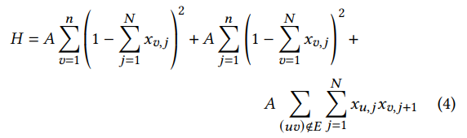
Algorithmic QUBO Formulations
Most of the current QUBO formulations are arithmetic. E.g.:
Our idea of Algorithmic QUBOs:
Don‘t create QUBO formulations directly – create (parameterized) algorithms/functions which build QUBOs using element-wise addition instructions

Slide 3

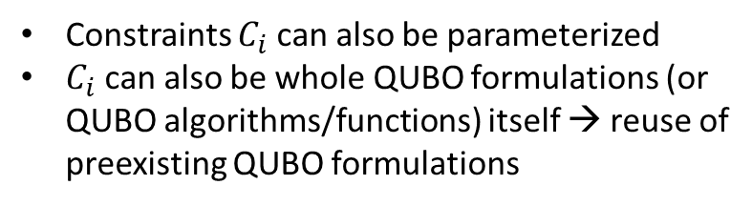
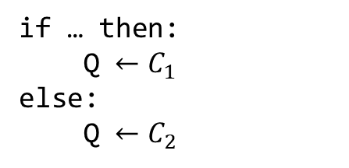

Arithmetic QUBOs vs. Algorithmic QUBOs
$𝒞=\{C_{1},C_{2},…\}$ # set of constraints
$𝒞=\{C_{1},C_{2},…\}$ # set of constraints
QUBO matrix is built with an algorithm and element-wise addition instructions:
QUBO matrix is a weighted sum of these constraints:
if … then:
Q $←C_{1}$
else:
Q $←C_{2}$
$$Q=A⋅C_{1}+B⋅C_{2}+…$$
Constraints $C_{i}$ can also be parameterized
$C_{i}$ can also be whole QUBO formulations (or QUBO algorithms/functions) itself → reuse of preexisting QUBO formulations

Slide 4

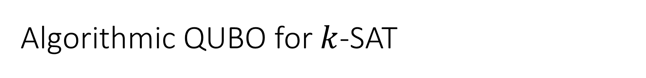
Algorithmic QUBO for $k$-SAT
Let $C$ be a clause with $k$ literals, there are $2^{k}$ possible assignments, of which $2^{k}−1$ assignments satisfy the clause and $1$ does not.
Example: $(a∨−b∨c)$
a | b | c | SAT
0 | 0 | 0 | 1
0 | 0 | 1 | 1
0 | 1 | 0 | 0
0 | 1 | 1 | 1
1 | 0 | 0 | 1
1 | 0 | 1 | 1
1 | 1 | 0 | 1
1 | 1 | 1 | 1

Slide 5
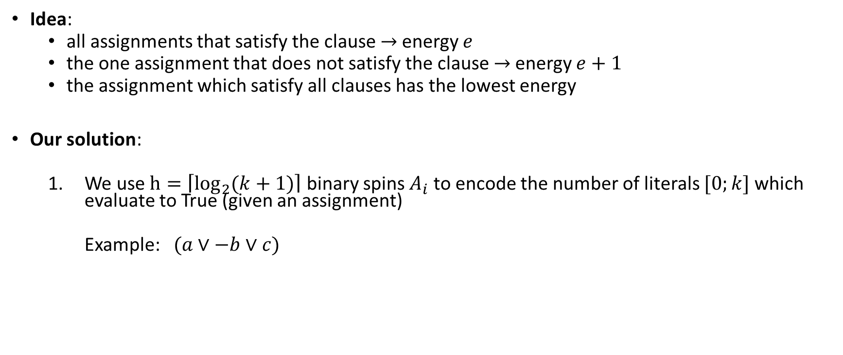
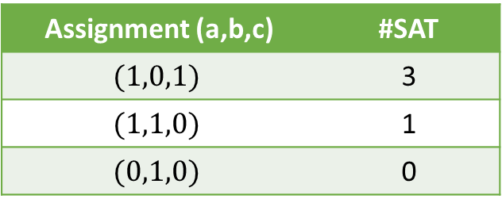
Algorithmic QUBO for $k$-SAT
Idea:
all assignments that satisfy the clause $→$energy $e$
the one assignment that does not satisfy the clause $→$energy $e+1$
the assignment which satisfy all clauses has the lowest energy
Our solution:
We use $h=\left\lceil \log_{2}{(k+1)}\right\rceil$ binary spins $A_{i}$ to encode the number of literals $[0;k]$ which evaluate to True (given an assignment)
Example: $(a∨−b∨c)$
Assignment (a,b,c) | #SAT
$$(1,0,1)$$ | 3
$$(1,1,0)$$ | 1
$$(0,1,0)$$ | 0

Slide 6
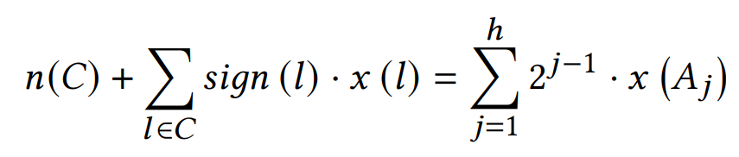

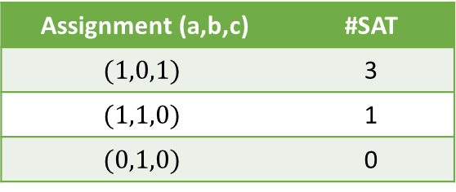
Algorithmic QUBO for $k$-SAT
Our solution:
We use $h=\left\lceil \log_{2}{(k+1)}\right\rceil$ binary spins $A_{i}$ to encode the number of literals $[0;k]$ which evaluated to True
(given an assignment $x$)
Example: $\left(a∨−b∨c\right)$
$n\left(C\right)=$ # negative literals (in the example: $1$)
$x\left(l\right)=$ assignment of the variable corresponding to literal $l$
$sign\left(l\right)=$ sign of the literal (in the example: $sign\left(a\right)=1, sign\left(−b\right)=−1$)
Assignment (a,b,c) | #SAT
$$(1,0,1)$$ | 3
$$(1,1,0)$$ | 1
$$(0,1,0)$$ | 0

Slide 7
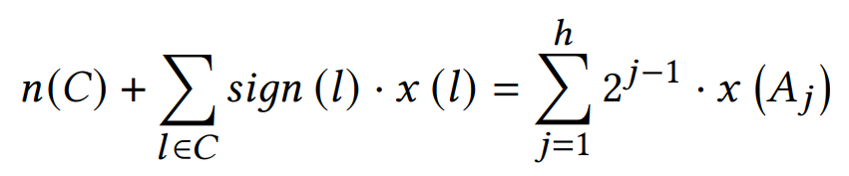
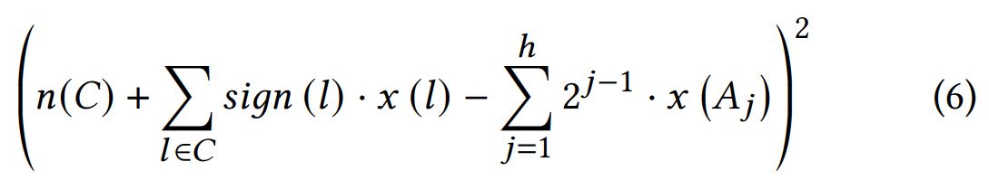

Algorithmic QUBO for $k$-SAT
Our solution:
We use $h=\left\lceil \log_{2}{(k+1)}\right\rceil$ binary spins $A_{i}$ to encode the number of literals $[0;k]$ which evaluate to True (given an assignment $x$)
Rewrite this equation as an optimization problem:

Slide 8
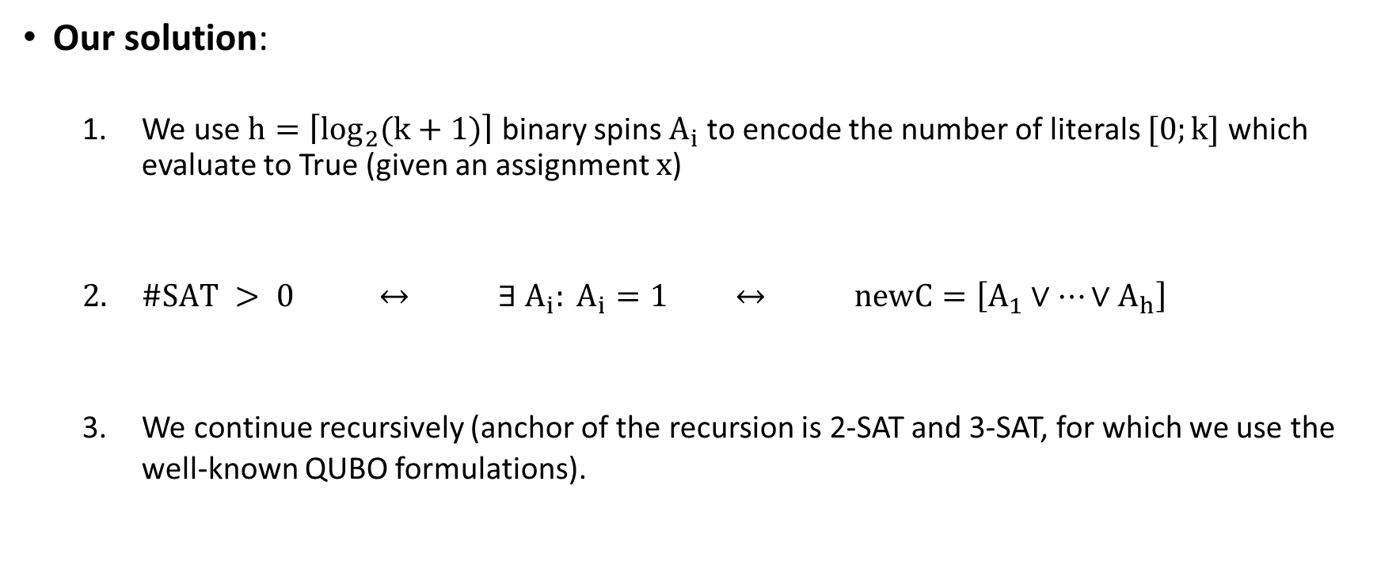
Algorithmic QUBO for $k$-SAT
Our solution:
We use $h=\left\lceil \log_{2}{(k+1)}\right\rceil$ binary spins $A_{i}$ to encode the number of literals $[0;k]$ which evaluate to True (given an assignment $x$)
$\#SAT > 0$ $↔$ $∃ A_{i}: A_{i}=1$ $↔$ $newC=\left[A_{1}∨…∨A_{h}\right]$
We continue recursively (anchor of the recursion is 2-SAT and 3-SAT, for which we use the well-known QUBO formulations).

Slide 9
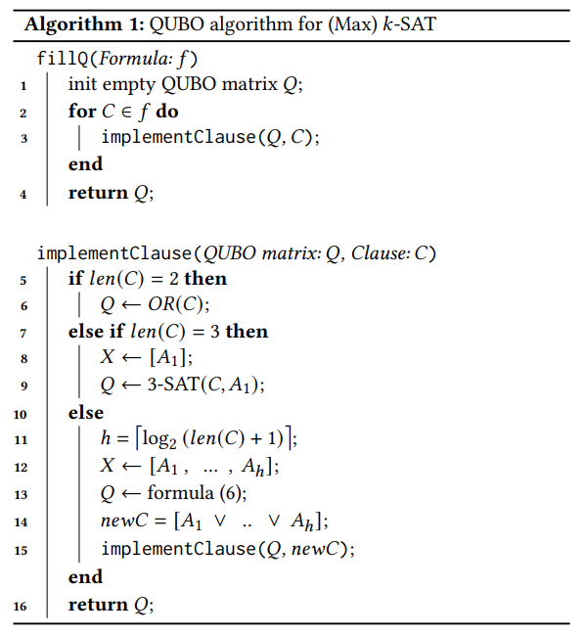
Algorithmic QUBO for $k$-SAT

Slide 10
Algorithmic QUBO for $k$-SAT

Slide 11
Algorithmic QUBO for $k$-SAT

Slide 12
Algorithmic QUBO for $k$-SAT

Slide 13
Algorithmic QUBO for $k$-SAT

Slide 14
Algorithmic QUBO for $k$-SAT

Slide 15
Algorithmic QUBO for $k$-SAT

Slide 16
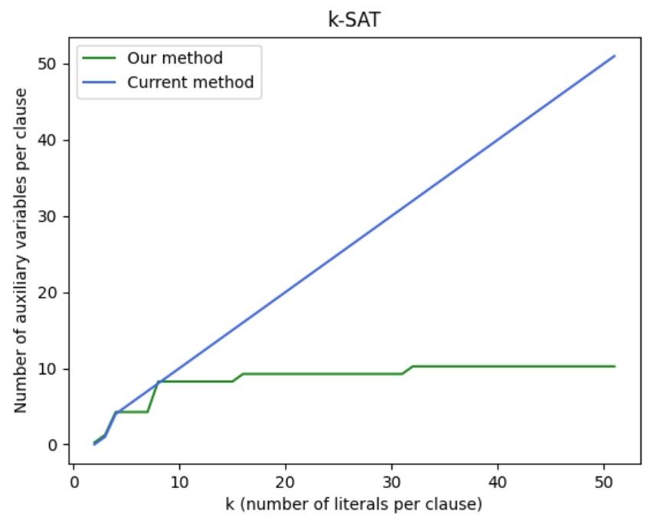
Algorithmic QUBO for $k$-SAT

Slide 17
Algorithmic QUBO Formulations
Advantages of Algorithmic QUBOs:
more flexible
Use branching and loops to decide which constraints are inserted (with which parameters) into the QUBO
2. easier to read/understand than arithmetic QUBOs (imagine how many indices you would need to write the recursion as an arithmetic QUBO)

Slide 18
Example

Slide 19
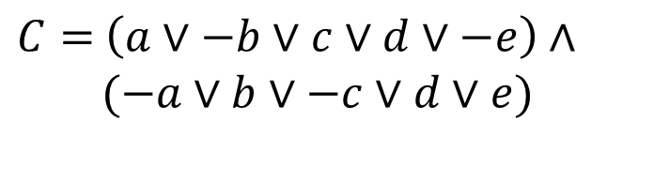
$C=$ $\left(a∨−b∨c∨d∨−e\right)∧$
$(−a∨b∨−c∨d∨e)$

Slide 20
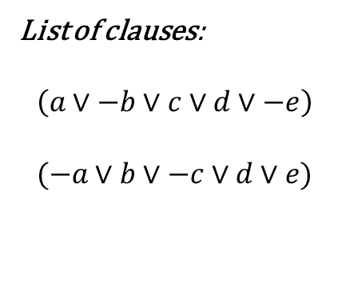
List of clauses:
$$\left(a∨−b∨c∨d∨−e\right)$$
$$(−a∨b∨−c∨d∨e)$$
$C=$ $\left(a∨−b∨c∨d∨−e\right)∧$
$(−a∨b∨−c∨d∨e)$

Slide 21
List of clauses:
$$\left(a∨−b∨c∨d∨−e\right)$$
$$(−a∨b∨−c∨d∨e)$$
$C=$ $\left(a∨−b∨c∨d∨−e\right)∧$
$(−a∨b∨−c∨d∨e)$

Slide 22
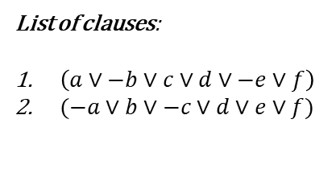
List of clauses:
$\left(a∨−b∨c∨d∨−e∨f\right)$
$(−a∨b∨−c∨d∨e∨f)$
QUBO Matrix Q:
 | a | b | c | d | e | f
a
b
c
d
e
f

Slide 23
List of clauses:
$\left(a∨−b∨c∨d∨−e∨f\right)$
$(−a∨b∨−c∨d∨e∨f)$
QUBO Matrix Q:
 | a | b | c | d | e | f
a
b
c
d
e
f

Slide 24
List of clauses:
$\left(a∨−b∨c∨d∨−e∨f\right)$
$(−a∨b∨−c∨d∨e∨f)$
QUBO Matrix Q:
 | a | b | c | d | e | f
a
b
c
d
e
f

Slide 25
List of clauses:
$\left(a∨−b∨c∨d∨−e∨f\right)$
$(−a∨b∨−c∨d∨e∨f)$
QUBO Matrix Q:
 | a | b | c | d | e | f
a
b
c
d
e
f

Slide 26
List of clauses:
$\left(a∨−b∨c∨d∨−e∨f\right)$
$(−a∨b∨−c∨d∨e∨f)$
QUBO Matrix Q:
 | a | b | c | d | e | f
a
b
c
d
e
f

Slide 27
List of clauses:
$\left(a∨−b∨c∨d∨−e∨f\right)$
$(−a∨b∨−c∨d∨e∨f)$
QUBO Matrix Q:
 | a | b | c | d | e | f
a
b
c
d
e
f

Slide 28
List of clauses:
$\left(a∨−b∨c∨d∨−e∨f\right)$
$(−a∨b∨−c∨d∨e∨f)$
QUBO Matrix Q:
 | a | b | c | d | e | f
a
b
c
d
e
f

Slide 29
List of clauses:
$\left(a∨−b∨c∨d∨−e∨f\right)$
$(−a∨b∨−c∨d∨e∨f)$
QUBO Matrix Q:
 | a | b | c | d | e | f
a
b
c
d
e
f

Slide 30

List of clauses:
$\left(a∨−b∨c∨d∨−e∨f\right)$
$(−a∨b∨−c∨d∨e∨f)$
QUBO Matrix Q:
 | a | b | c | d | e | f
a
b
c
d
e
f
$$h=\left\lceil \log_{2}{(6+1)}\right\rceil =3$$

Slide 31
List of clauses:
$\left(a∨−b∨c∨d∨−e∨f\right)$
$(−a∨b∨−c∨d∨e∨f)$
QUBO Matrix Q:
 | a | b | c | d | e | f | A1 | A2 | A3
a
b
c
d
e
f
A1
A2
A3

Slide 32
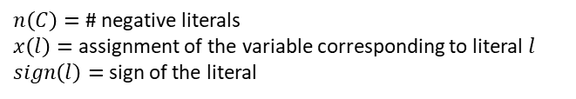
List of clauses:
$\left(a∨−b∨c∨d∨−e∨f\right)$
$(−a∨b∨−c∨d∨e∨f)$
QUBO Matrix Q:
 | a | b | c | d | e | f | A1 | A2 | A3
a
b
c
d
e
f
A1
A2
A3
$n\left(C\right)=$ # negative literals
$x\left(l\right)=$ assignment of the variable corresponding to literal $l$
$sign\left(l\right)=$ sign of the literal

Slide 33
List of clauses:
$\left(a∨−b∨c∨d∨−e∨f\right)$
$(−a∨b∨−c∨d∨e∨f)$
QUBO Matrix Q:
 | a | b | c | d | e | f | A1 | A2 | A3
a
b
c
d
e
f
A1
A2
A3
$n\left(C\right)=$ # negative literals
$x\left(l\right)=$ assignment of the variable corresponding to literal $l$
$sign\left(l\right)=$ sign of the literal

Slide 34

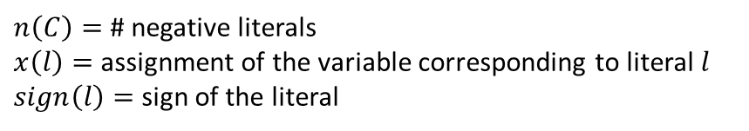
$$\left(a∨−b∨c∨d∨−e∨f\right)$$
$n\left(C\right)=$ # negative literals
$x\left(l\right)=$ assignment of the variable corresponding to literal $l$
$sign\left(l\right)=$ sign of the literal

Slide 35
$$\left(a∨−b∨c∨d∨−e∨f\right)$$
$${\left(2+a−b+c+d−e+f−A_{1}−2A_{2}−4A_{3}\right)}^{2}$$
$n\left(C\right)=$ # negative literals
$x\left(l\right)=$ assignment of the variable corresponding to literal $l$
$sign\left(l\right)=$ sign of the literal

Slide 36
$$\left(a∨−b∨c∨d∨−e∨f\right)$$
$${\left(2+a−b+c+d−e+f−A_{1}−2A_{2}−4A_{3}\right)}^{2}$$
$n\left(C\right)=$ # negative literals
$x\left(l\right)=$ assignment of the variable corresponding to literal $l$
$sign\left(l\right)=$ sign of the literal

Slide 37
$$\left(a∨−b∨c∨d∨−e∨f\right)$$
$${\left(2+a−b+c+d−e+f−A_{1}−2A_{2}−4A_{3}\right)}^{2}$$
$n\left(C\right)=$ # negative literals
$x\left(l\right)=$ assignment of the variable corresponding to literal $l$
$sign\left(l\right)=$ sign of the literal

Slide 38
$$\left(a∨−b∨c∨d∨−e∨f\right)$$
$${\left(2+a−b+c+d−e+f−A_{1}−2A_{2}−4A_{3}\right)}^{2}$$
$n\left(C\right)=$ # negative literals
$x\left(l\right)=$ assignment of the variable corresponding to literal $l$
$sign\left(l\right)=$ sign of the literal

Slide 39
List of clauses:
$\left(a∨−b∨c∨d∨−e∨f\right)$
$(−a∨b∨−c∨d∨e∨f)$
QUBO Matrix Q:
 | a | b | c | d | e | f | A1 | A2 | A3
a | 5 | -2 | 2 | 2 | -2 | 2 | -2 | -4 | -8
b |  | -3 | -2 | -2 | 2 | -2 | 2 | 4 | 8
c |  |  | 5 | 2 | -2 | 2 | -2 | -4 | -8
d |  |  |  | 5 | -2 | 2 | -2 | -4 | -8
e |  |  |  |  | -3 | -2 | 2 | 4 | 8
f |  |  |  |  |  | 5 | -2 | -4 | -8
A1 |  |  |  |  |  |  | -3 | 4 | 8
A2 |  |  |  |  |  |  |  | -4 | 16
A3 |  |  |  |  |  |  |  |  | 0

Slide 40
List of clauses:
$\left(a∨−b∨c∨d∨−e∨f\right)$
$(−a∨b∨−c∨d∨e∨f)$
QUBO Matrix Q:
 | a | b | c | d | e | f | A1 | A2 | A3
a | 5 | -2 | 2 | 2 | -2 | 2 | -2 | -4 | -8
b |  | -3 | -2 | -2 | 2 | -2 | 2 | 4 | 8
c |  |  | 5 | 2 | -2 | 2 | -2 | -4 | -8
d |  |  |  | 5 | -2 | 2 | -2 | -4 | -8
e |  |  |  |  | -3 | -2 | 2 | 4 | 8
f |  |  |  |  |  | 5 | -2 | -4 | -8
A1 |  |  |  |  |  |  | -3 | 4 | 8
A2 |  |  |  |  |  |  |  | -4 | 16
A3 |  |  |  |  |  |  |  |  | 0

Slide 41
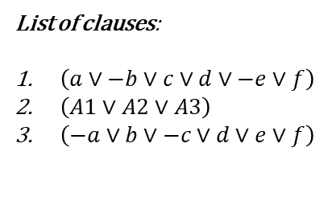
List of clauses:
$\left(a∨−b∨c∨d∨−e∨f\right)$
$\left(A1∨A2∨A3\right)$
$\left(−a∨b∨−c∨d∨e∨f\right)$
QUBO Matrix Q:
 | a | b | c | d | e | f | A1 | A2 | A3
a | 5 | -2 | 2 | 2 | -2 | 2 | -2 | -4 | -8
b |  | -3 | -2 | -2 | 2 | -2 | 2 | 4 | 8
c |  |  | 5 | 2 | -2 | 2 | -2 | -4 | -8
d |  |  |  | 5 | -2 | 2 | -2 | -4 | -8
e |  |  |  |  | -3 | -2 | 2 | 4 | 8
f |  |  |  |  |  | 5 | -2 | -4 | -8
A1 |  |  |  |  |  |  | -3 | 4 | 8
A2 |  |  |  |  |  |  |  | -4 | 16
A3 |  |  |  |  |  |  |  |  | 0

Slide 42
List of clauses:
$\left(a∨−b∨c∨d∨−e∨f\right)$
$\left(A1∨A2∨A3\right)$
$\left(−a∨b∨−c∨d∨e∨f\right)$
QUBO Matrix Q:
 | a | b | c | d | e | f | A1 | A2 | A3
a | 5 | -2 | 2 | 2 | -2 | 2 | -2 | -4 | -8
b |  | -3 | -2 | -2 | 2 | -2 | 2 | 4 | 8
c |  |  | 5 | 2 | -2 | 2 | -2 | -4 | -8
d |  |  |  | 5 | -2 | 2 | -2 | -4 | -8
e |  |  |  |  | -3 | -2 | 2 | 4 | 8
f |  |  |  |  |  | 5 | -2 | -4 | -8
A1 |  |  |  |  |  |  | -3 | 4 | 8
A2 |  |  |  |  |  |  |  | -4 | 16
A3 |  |  |  |  |  |  |  |  | 0

Slide 43
List of clauses:
$\left(a∨−b∨c∨d∨−e∨f\right)$
$\left(A1∨A2∨A3\right)$
$\left(−a∨b∨−c∨d∨e∨f\right)$
QUBO Matrix Q:
 | a | b | c | d | e | f | A1 | A2 | A3
a | 5 | -2 | 2 | 2 | -2 | 2 | -2 | -4 | -8
b |  | -3 | -2 | -2 | 2 | -2 | 2 | 4 | 8
c |  |  | 5 | 2 | -2 | 2 | -2 | -4 | -8
d |  |  |  | 5 | -2 | 2 | -2 | -4 | -8
e |  |  |  |  | -3 | -2 | 2 | 4 | 8
f |  |  |  |  |  | 5 | -2 | -4 | -8
A1 |  |  |  |  |  |  | -3 | 4 | 8
A2 |  |  |  |  |  |  |  | -4 | 16
A3 |  |  |  |  |  |  |  |  | 0

Slide 44
List of clauses:
$\left(a∨−b∨c∨d∨−e∨f\right)$
$\left(A1∨A2∨A3\right)$
$\left(−a∨b∨−c∨d∨e∨f\right)$
QUBO Matrix Q:
 | a | b | c | d | e | f | A1 | A2 | A3
a | 5 | -2 | 2 | 2 | -2 | 2 | -2 | -4 | -8
b |  | -3 | -2 | -2 | 2 | -2 | 2 | 4 | 8
c |  |  | 5 | 2 | -2 | 2 | -2 | -4 | -8
d |  |  |  | 5 | -2 | 2 | -2 | -4 | -8
e |  |  |  |  | -3 | -2 | 2 | 4 | 8
f |  |  |  |  |  | 5 | -2 | -4 | -8
A1 |  |  |  |  |  |  | -3 | 4 | 8
A2 |  |  |  |  |  |  |  | -4 | 16
A3 |  |  |  |  |  |  |  |  | 0

Slide 45
List of clauses:
$\left(a∨−b∨c∨d∨−e∨f\right)$
$\left(A1∨A2∨A3\right)$
$\left(−a∨b∨−c∨d∨e∨f\right)$
QUBO Matrix Q:
 | a | b | c | d | e | f | A1 | A2 | A3 | A4
a | 5 | -2 | 2 | 2 | -2 | 2 | -2 | -4 | -8
b |  | -3 | -2 | -2 | 2 | -2 | 2 | 4 | 8
c |  |  | 5 | 2 | -2 | 2 | -2 | -4 | -8
d |  |  |  | 5 | -2 | 2 | -2 | -4 | -8
e |  |  |  |  | -3 | -2 | 2 | 4 | 8
f |  |  |  |  |  | 5 | -2 | -4 | -8
A1 |  |  |  |  |  |  | -3 | 4 | 8
A2 |  |  |  |  |  |  |  | -4 | 16
A3 |  |  |  |  |  |  |  |  | 0
A4

Slide 46
List of clauses:
$\left(a∨−b∨c∨d∨−e∨f\right)$
$\left(A1∨A2∨A3\right)$
$\left(−a∨b∨−c∨d∨e∨f\right)$
QUBO Matrix Q:
 | a | b | c | d | e | f | A1 | A2 | A3 | A4
a | 5 | -2 | 2 | 2 | -2 | 2 | -2 | -4 | -8
b |  | -3 | -2 | -2 | 2 | -2 | 2 | 4 | 8
c |  |  | 5 | 2 | -2 | 2 | -2 | -4 | -8
d |  |  |  | 5 | -2 | 2 | -2 | -4 | -8
e |  |  |  |  | -3 | -2 | 2 | 4 | 8
f |  |  |  |  |  | 5 | -2 | -4 | -8
A1 |  |  |  |  |  |  | -3 | 6 | 8 | -2
A2 |  |  |  |  |  |  |  | -4 | 16 | -2
A3 |  |  |  |  |  |  |  |  | -1 | 1
A4 |  |  |  |  |  |  |  |  |  | 1

Slide 47
List of clauses:
$\left(a∨−b∨c∨d∨−e∨f\right)$
$\left(A1∨A2∨A3\right)$
$\left(−a∨b∨−c∨d∨e∨f\right)$
QUBO Matrix Q:
 | a | b | c | d | e | f | A1 | A2 | A3 | A4
a | 5 | -2 | 2 | 2 | -2 | 2 | -2 | -4 | -8
b |  | -3 | -2 | -2 | 2 | -2 | 2 | 4 | 8
c |  |  | 5 | 2 | -2 | 2 | -2 | -4 | -8
d |  |  |  | 5 | -2 | 2 | -2 | -4 | -8
e |  |  |  |  | -3 | -2 | 2 | 4 | 8
f |  |  |  |  |  | 5 | -2 | -4 | -8
A1 |  |  |  |  |  |  | -3 | 6 | 8 | -2
A2 |  |  |  |  |  |  |  | -4 | 16 | -2
A3 |  |  |  |  |  |  |  |  | -1 | 1
A4 |  |  |  |  |  |  |  |  |  | 1
6 ancilla qubits → 4 ancilla qubits

Slide 48
List of clauses:
$\left(a∨−b∨c∨d∨−e∨f\right)$
$\left(A1∨A2∨A3\right)$
$\left(−a∨b∨−c∨d∨e∨f\right)$
QUBO Matrix Q:
 | a | b | c | d | e | f | A1 | A2 | A3 | A4
a | 5 | -2 | 2 | 2 | -2 | 2 | -2 | -4 | -8
b |  | -3 | -2 | -2 | 2 | -2 | 2 | 4 | 8
c |  |  | 5 | 2 | -2 | 2 | -2 | -4 | -8
d |  |  |  | 5 | -2 | 2 | -2 | -4 | -8
e |  |  |  |  | -3 | -2 | 2 | 4 | 8
f |  |  |  |  |  | 5 | -2 | -4 | -8
A1 |  |  |  |  |  |  | -3 | 6 | 8 | -2
A2 |  |  |  |  |  |  |  | -4 | 16 | -2
A3 |  |  |  |  |  |  |  |  | -1 | 1
A4 |  |  |  |  |  |  |  |  |  | 1

Slide 49

Let's get into the code ...

Slide 50

Let's get into the code ... after the break

Slide 51
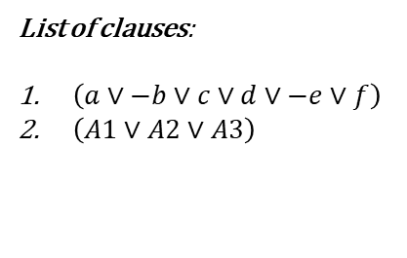


List of clauses:
$\left(a∨−b∨c∨d∨−e∨f\right)$
$\left(A1∨A2∨A3\right)$
QUBO Matrix Q:
 | a | b | c | d | e | f | A1 | A2 | A3 | A4
a | 5 | -2 | 2 | 2 | -2 | 2 | -2 | -4 | -8
b |  | -3 | -2 | -2 | 2 | -2 | 2 | 4 | 8
c |  |  | 5 | 2 | -2 | 2 | -2 | -4 | -8
d |  |  |  | 5 | -2 | 2 | -2 | -4 | -8
e |  |  |  |  | -3 | -2 | 2 | 4 | 8
f |  |  |  |  |  | 5 | -2 | -4 | -8
A1 |  |  |  |  |  |  | -3 | 6 | 8 | -2
A2 |  |  |  |  |  |  |  | -4 | 16 | -2
A3 |  |  |  |  |  |  |  |  | -1 | 1
A4 |  |  |  |  |  |  |  |  |  | 1
$$[1, 0, 1, 1, 0, 1]$$
$$E = −5$$

Slide 52
List of clauses:
$\left(a∨−b∨c∨d∨−e∨f\right)$
$\left(A1∨A2∨A3\right)$
QUBO Matrix Q:
 | a | b | c | d | e | f | A1 | A2 | A3 | A4
a | 5 | -2 | 2 | 2 | -2 | 2 | -2 | -4 | -8
b |  | -3 | -2 | -2 | 2 | -2 | 2 | 4 | 8
c |  |  | 5 | 2 | -2 | 2 | -2 | -4 | -8
d |  |  |  | 5 | -2 | 2 | -2 | -4 | -8
e |  |  |  |  | -3 | -2 | 2 | 4 | 8
f |  |  |  |  |  | 5 | -2 | -4 | -8
A1 |  |  |  |  |  |  | -3 | 6 | 8 | -2
A2 |  |  |  |  |  |  |  | -4 | 16 | -2
A3 |  |  |  |  |  |  |  |  | -1 | 1
A4 |  |  |  |  |  |  |  |  |  | 1
$$[1, 0, 1, 1, 0, 1]$$
$$E = −5$$

Slide 53

List of clauses:
$\left(a∨−b∨c∨d∨−e∨f\right)$
$\left(A1∨A2∨A3\right)$
QUBO Matrix Q:
 | a | b | c | d | e | f | A1 | A2 | A3 | A4
a | 5 | -2 | 2 | 2 | -2 | 2 | -2 | -4 | -8
b |  | -3 | -2 | -2 | 2 | -2 | 2 | 4 | 8
c |  |  | 5 | 2 | -2 | 2 | -2 | -4 | -8
d |  |  |  | 5 | -2 | 2 | -2 | -4 | -8
e |  |  |  |  | -3 | -2 | 2 | 4 | 8
f |  |  |  |  |  | 5 | -2 | -4 | -8
A1 |  |  |  |  |  |  | -3 | 6 | 8 | -2
A2 |  |  |  |  |  |  |  | -4 | 16 | -2
A3 |  |  |  |  |  |  |  |  | -1 | 1
A4 |  |  |  |  |  |  |  |  |  | 1
$$[0, 0, 0, 0, 0, 1]$$
$$E = −5$$

Slide 54


List of clauses:
$\left(a∨−b∨c∨d∨−e∨f\right)$
$\left(A1∨A2∨A3\right)$
QUBO Matrix Q:
 | a | b | c | d | e | f | A1 | A2 | A3 | A4
a | 5 | -2 | 2 | 2 | -2 | 2 | -2 | -4 | -8
b |  | -3 | -2 | -2 | 2 | -2 | 2 | 4 | 8
c |  |  | 5 | 2 | -2 | 2 | -2 | -4 | -8
d |  |  |  | 5 | -2 | 2 | -2 | -4 | -8
e |  |  |  |  | -3 | -2 | 2 | 4 | 8
f |  |  |  |  |  | 5 | -2 | -4 | -8
A1 |  |  |  |  |  |  | -3 | 6 | 8 | -2
A2 |  |  |  |  |  |  |  | -4 | 16 | -2
A3 |  |  |  |  |  |  |  |  | -1 | 1
A4 |  |  |  |  |  |  |  |  |  | 1
$$[0, 1, 0, 0, 1, 0]$$
$$E = −4$$

